Slide 1

HOTEL BOOKING
ANALYSIS
PRESENTED BY
RUPESH PATIL
GUIDED BY ABHISHEK WAHVAL

Slide 2
TABLE OF CONTENT
PROJECT SUMMARY
ANALYSING DATA
EXPECTED OUTCOME
4) ABOUT DATA
5) PROBLEM STATEMENT
6) DATA CLEANING
7) DATA VISUALISATION AND ANALYSIS
8) CONCLUSION

Slide 3
Project overview
This study examines the performance of City Hotel and Resort Hotel from 2015 to 2017. It focuses on areas such as operational efficiency, customer satisfaction, financial results, occupancy rates, and marketing strategies.
The main goal is to identify insights that can help both hotels improve their operations, increase profitability, and achieve steady, long-term growth .

Slide 4
DATA ANALYSIS

Slide 5
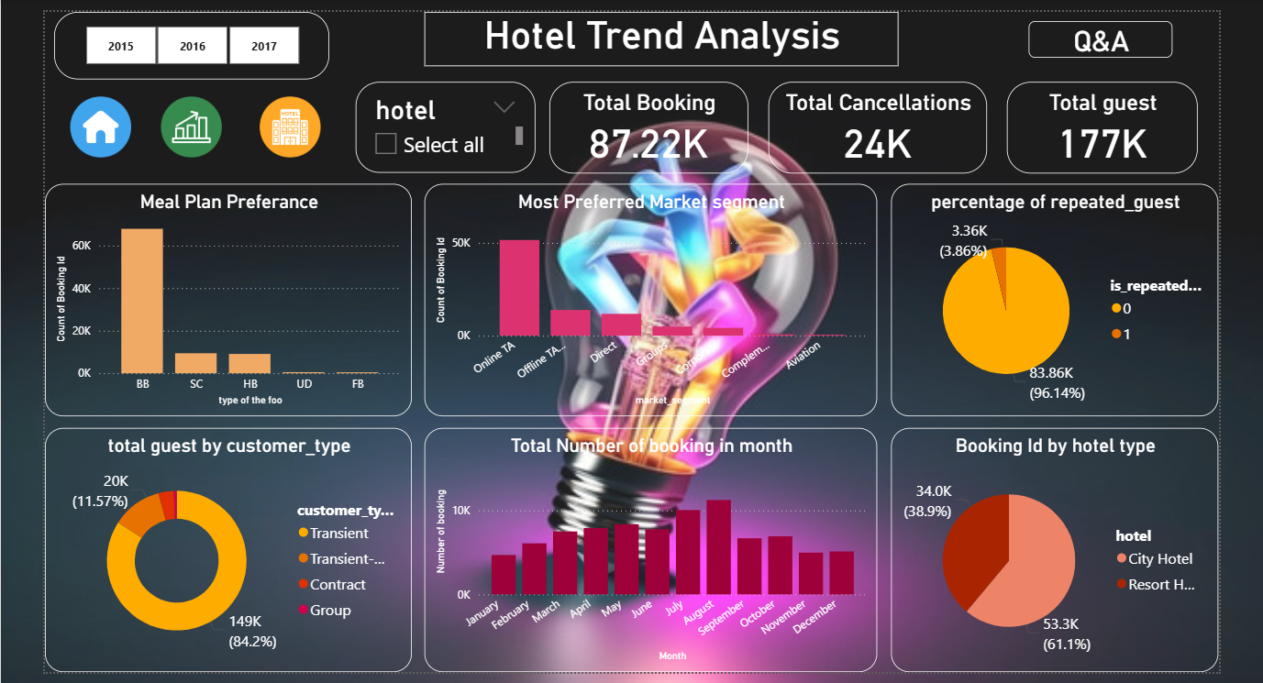

Slide 6
DATA
PREPARATION
Remove errors, Remove blank records, Removed duplicates and handled missing values. Created new columns: Booking ID, arrival date, total night stays, total persons, customer satisfaction. Removed columns: arrival date week column, company, days in waiting list. Meargedarrival month, arrival date, arrival year Columns into a new column arrival date (respectively). add custom column of total night Stayes in hotel ( addition of columns stays in weekend nights and stays in weekday nights). add custom column of total persons (adding columns adults, childern, babies ). remove arrival date week column. In country column replace NULL value with self- country. added conditional column of customer satisfacttion ( if reserved room type is equal to assigned room type). In agent column replace NULL value with Direct-booking. Remove company column because 97% values are NULL.

Slide 7
DATA VISUALIZATION

Slide 8
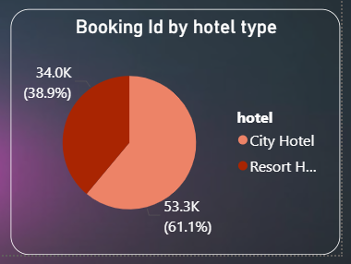
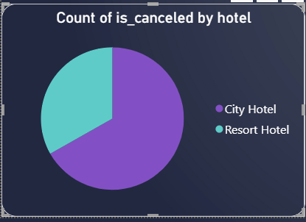
City Hotels account for the majority of bookings with 53.42K, and Resort Hotels have 33.97K bookings.
City Hotels are clearly more popular compared to Resort Hotels.
City Hotels have the highest count of cancellations.
The cancellation rate is significantly higher for City Hotels compared to Resort Hotels.

Slide 9
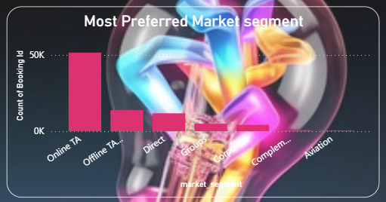
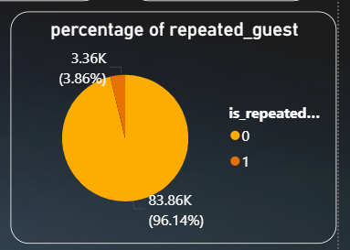
Online TA (Travel Agency) is the dominant market segment.
Offline TA/TO (Tour Operator) and Direct segments are demonstrating similar performance.
The number of bookings from Groups, Corporate, Complementary, and Aviation segments is much lower.
The number of repeated guests is nearly identical for City Hotels and Resort Hotels.
City Hotels have a slightly higher percentage at 50.01%, while Resort Hotels contribute 49.99% of repeated guests

Slide 10
EXPECTED OUTCOMES
1
2
3
4
Improved Revenue Management
Enhanced Guest Experience
Reduced Cancellations Rate
Smarter Inventory Allocation
5
Targeted Marketing and Segmentation

Slide 11

Dataset Overview & Key Fields
Primary key: BOOKING_ID (unique record identifier)
Timing & stay: LEAD_TIME (hours), BOOKING_DATE, ARRIVAL_DATE, TOTAL_NIGHT_STAYS, STAYS_IN_WEEKEND_NIGHTS
Booking context: HOTEL_TYPE, MARKET_SEGMENT, DISTRIBUTION_CHANNEL
Reservation state: IS_CANCELLATION, PREVIOUS_CANCELLATION, RESERVATION_STATUS, RESERVATION_STATUS_DATE
Guest composition: ADULTS, CHILDREN, BABIES, TOTAL_PERSONS

Slide 12

Data Quality Checklist — What to inspect first
Uniqueness
Verify BOOKING_ID is unique. Flag duplicates and create incident log.
Completeness
Null rates for essential fields: ARRIVAL_DATE, TOTAL_NIGHT_STAYS, ADR, HOTEL_TYPE.
Validity & Types
Ensure numeric fields (ADULTS, CHILDREN, LEAD_TIME, ADR) are numeric and within realistic ranges.
Consistency
Matching RESERVED_ROOM_TYPE vs ASSIGNED_ROOM_TYPE codes; consistent MARKET_SEGMENT labels.

Slide 13

Key KPIs for Hotel Operations
80%
$120
$96
Occupancy Rate
ADR
RevPAR
Rooms sold / rooms available (by date).
Average daily rate per occupied room (cleaned & trimmed).
Revenue per available room = ADR * Occupancy.
7%
Cancellation Rate
Cancelled bookings / total bookings (segment by lead time & channel).
Use segmentation by HOTEL_TYPE, MARKET_SEGMENT, DISTRIBUTION_CHANNEL, and COUNTRY for deeper insights.

Slide 14
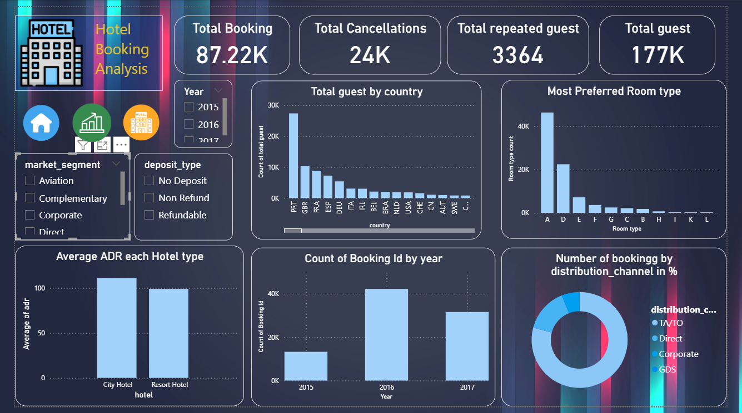
Hotel Booking Dashboard

Slide 15
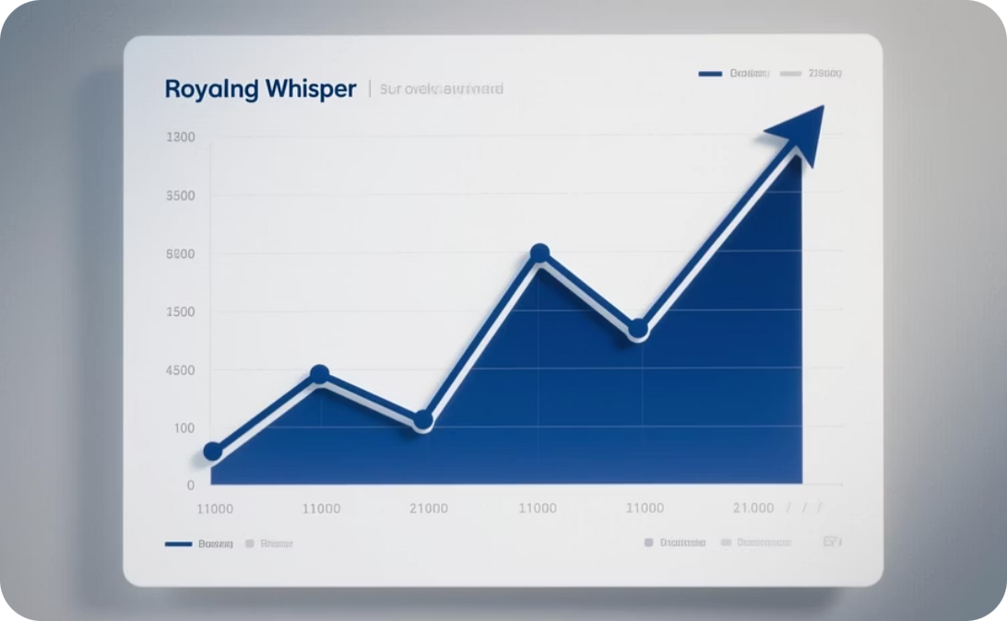


Example Charts to Include
Bookings Time Series
Revenue by Channel
Cancellation Heatmap
Daily/weekly booked rooms and rolling 7-day average to smooth seasonality.
Stacked bars for direct, TA/TO, corporate, GDS — helps prioritize distribution strategy.
Map cancellations by arrival date and lead time to identify risk windows.

Slide 16
conclusion
City Hotels has a higher overall booking rate than Resort Hotels. To improve this, Resort Hotels should consider the services provided by City Hotels to boost the number of bookings.
The City Hotel has a higher rate of cancellations than Resort Hotels. By implementing focused strategies to retain guests, the hotel could substantially decrease the impact on its revenue.
August is one of the peak months for bookings. Hotels should manage their resources during these months and conduct promotional activities during months with fewer bookings.
By promoting early-bird specials, hotels can encourage reservations well before the usual lead time of 75 to 85 days, enhancing financial liquidity and diminishing the rates of last-minute room availability.
Focusing on ‘BB’ as the preferred meal choice and customizing the dining options and experiences could improve guest contentment.
Concentrating marketing efforts specifically in Portugal, the UK, and France, where most guests come from, could increase reservation numbers.
The low rate of returning guests highlights the opportunity for implementing loyalty programs to increase the number of repeat stays.
A considerable volume of reservations is secured via agents, highlighting the need to cultivate robust partnerships with these intermediaries.

Slide 17
Thank you!

